Slide 1

BMD_ENG 301 Discussion 1: Neuroanatomy
TAs: Emily Schafer and Wei Hong Yeo
emilyschafer2023@u.northwestern.edu
weihong.yeo@northwestern.edu
September 27th and September 30th

Slide 2



TA Contact Information and Office Hours
TA: Emily Schafer, PhD Candidate in Biomedical Engineering
Research: “bioelectronic” sensors for neural engineering (Rivnay Lab)
Olly
Likes:
Cats (all animals really)
Traveling
Nature
Talking about cool science/science policies

Slide 3
TA Contact Information and Office Hours
Office hours
“No Strings Attached”
You don’t need to come with questions prepared
I am here as a resource, whatever that means to you ☺
Tuesdays 2:30-3:30pm in Tech C211
(Or by appointment via Zoom)
Contact me via email – I will do my best to respond within 24 hours on weekdays
emilyschafer2023@u.northwestern.edu

Slide 4
Course Logistics and Expectations
COVID-19 policies
Attendance
Format
Slides will be posted after each section
In-class Expectations:
Arrive on time
Be ready to be engaged
Follow good discussion practices
Use this as an opportunity to find study buddies
Using PollEv.com:
Go to http://PollEv.com/emilyschafer216 in another browser for answering questions throughout discussion

Slide 5
Review Question #1
Gray matter differs from white matter because gray matter _____ and white matter _____.
is in the PNS; is in the CNS
contains neuronal cell bodies; contains axons
is part of the sympathetic nervous system; is part of the parasympathetic nervous system
contains neurons; contains glia
is in the spinal cord; is in the brain

Slide 6
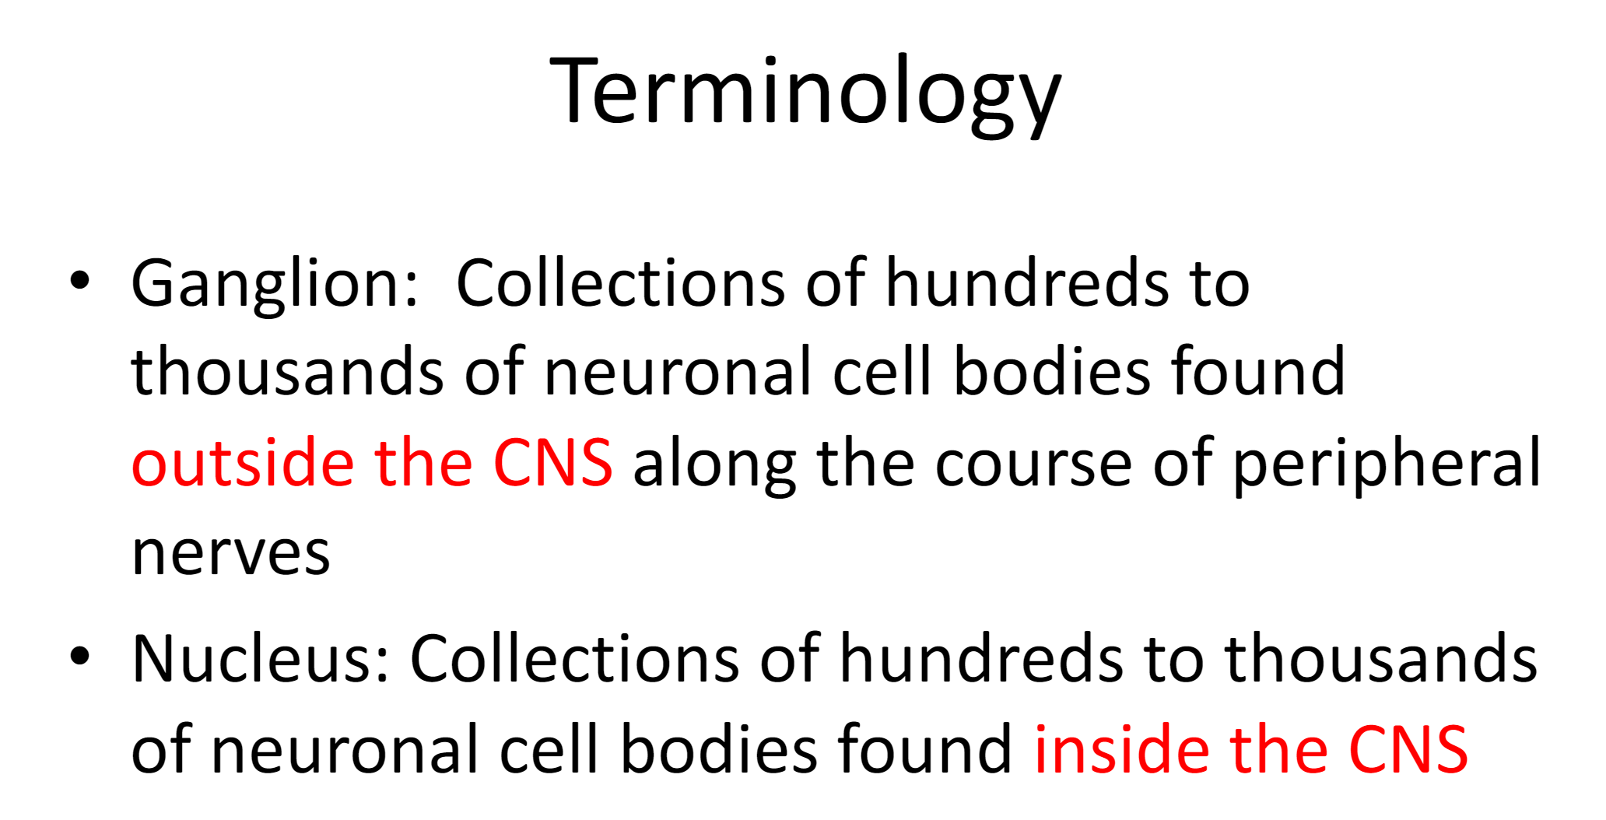

Slide 7
Review Question #2
The majority of the ___ cranial nerves arise from the ___ of the brain.
10; cortex
12; diencephalon
10; cerebellum
12; brainstem

Slide 8
Review Question #3
The deep groove that separates the right and left cerebral hemispheres is known as the:
Lateral fissure
Central sulcus
Postcentral gyrus
Precentral gyrus
Longitudinal fissure

Slide 9
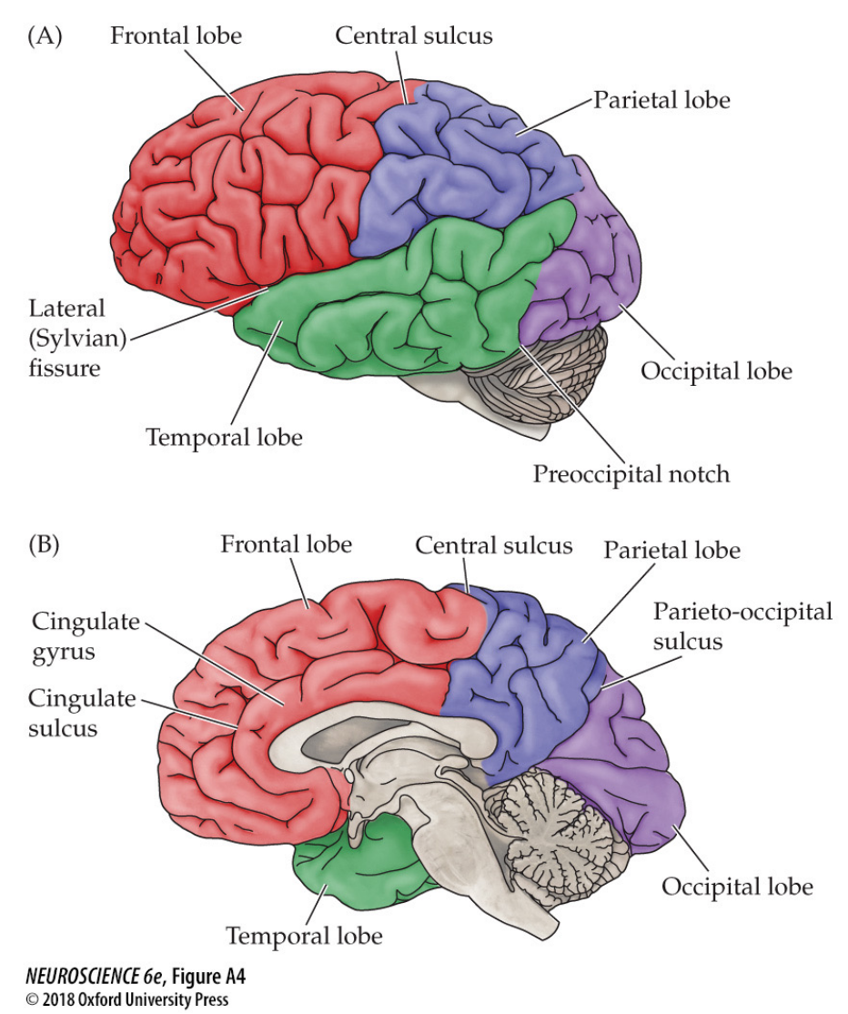

Slide 10
Review Question #4
The internal structures of the spinal cord are known to change shape and size with the location along the length of the spinal cord. Which of the following are correct statements about these changes?
i. Enlargements of the gray matter occur near the areas of the spinal cord responsible for the upper and lower limbs.
ii. The gray matter increases with distance down the spinal cord because of an increased number of interneurons.
iii. The white matter decreases with distance down the spinal cord because there are less axons needed to innervate the remaining areas of the body.
A. i only C. i and iii
B. i and ii D. All of the above

Slide 11
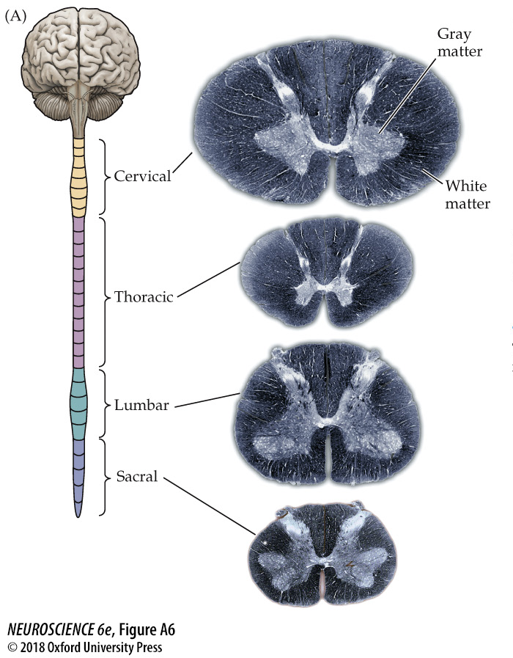
Review Question #4

Slide 12
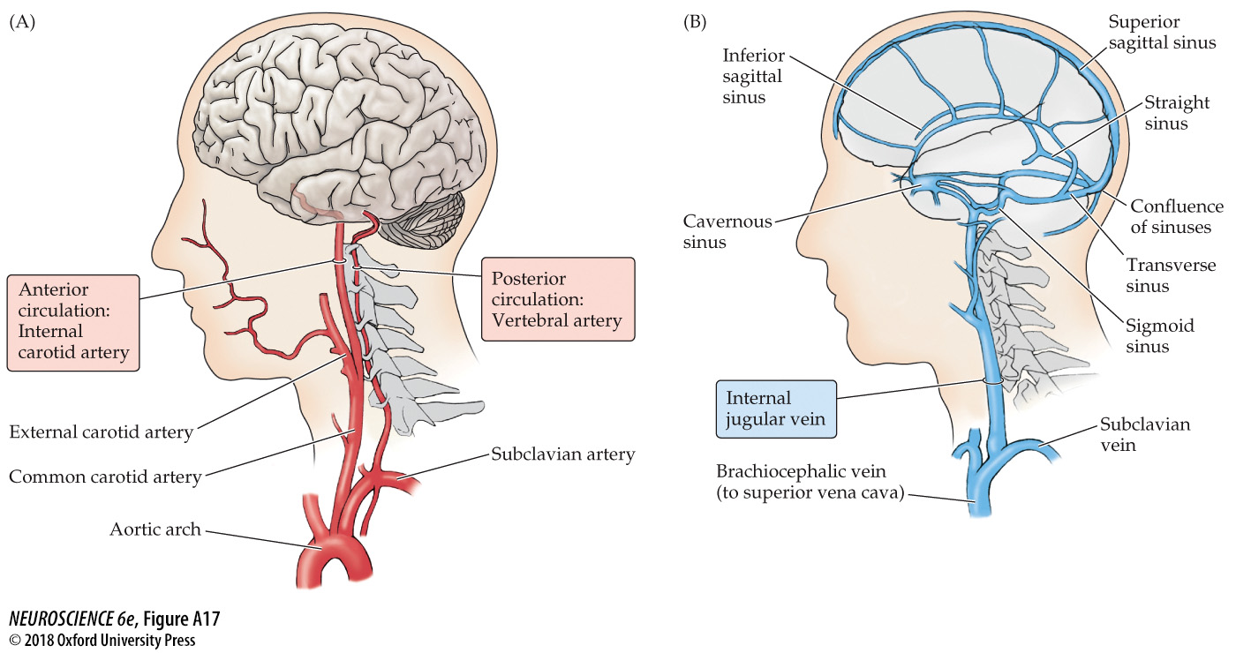
Blood Circulation in the Nervous Systems

Slide 13
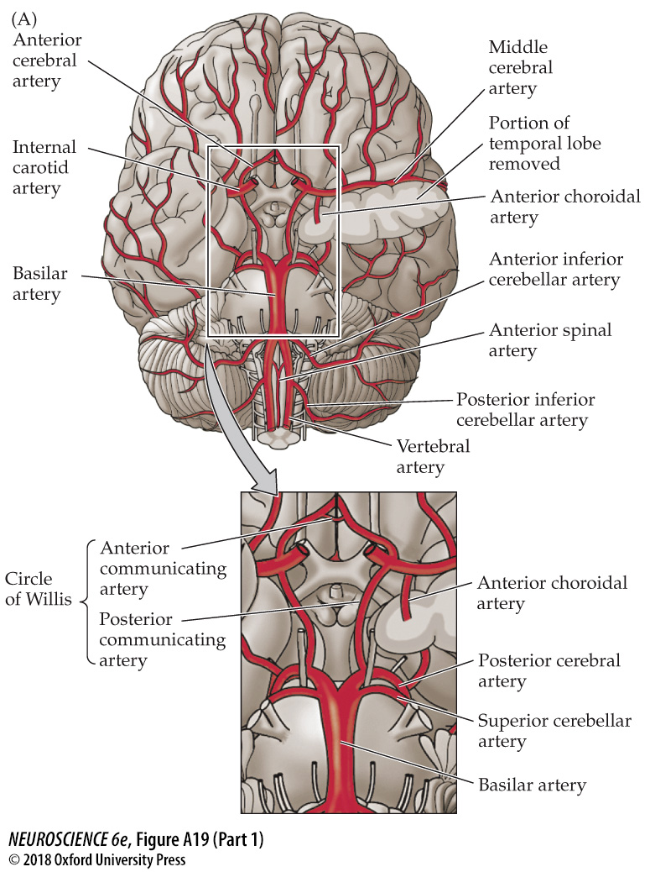
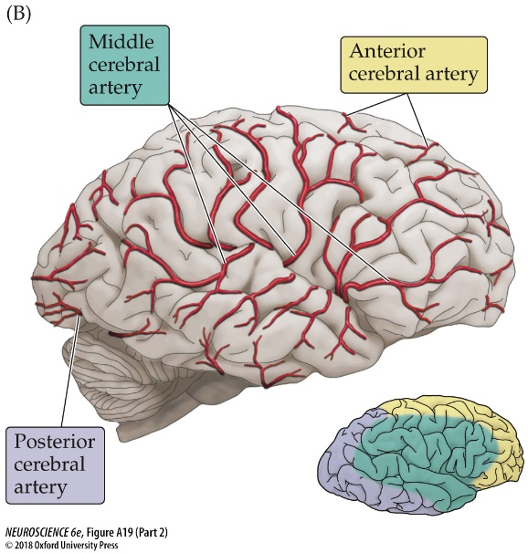
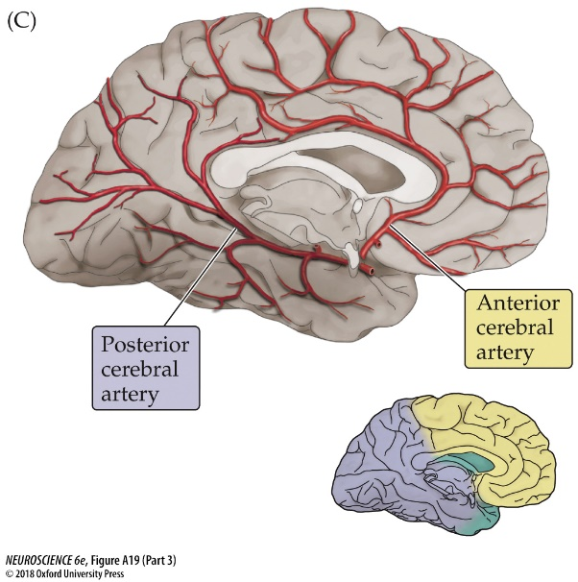
Blood Circulation in the Nervous Systems

Slide 14
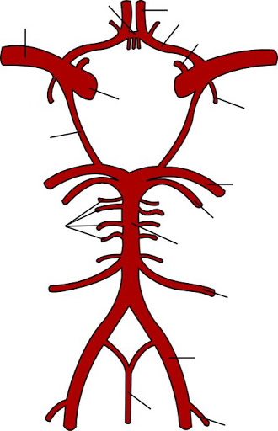
The Circle of Willis
Internal carotid artery
Pontine arteries
Basilar artery
Vertebral artery

Slide 15
The Circle of Willis
Anterior communicating artery
Anterior cerebral artery
Middle cerebral artery
Posterior communicating artery
Internal carotid artery
Posterior cerebral artery

Slide 16
The Circle of Willis
Superior cerebellar artery
Anterior inferior cerebellar artery (AICA)
Posterior inferior cerebellar artery (PICA)

Slide 17
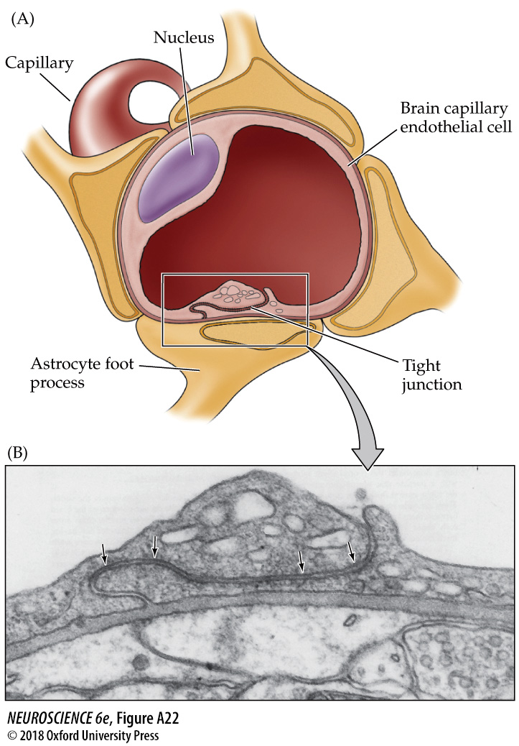
The Blood-Brain Barrier
Protection against pathogens, toxins, and dangerous concentrations of biomolecules

Slide 18
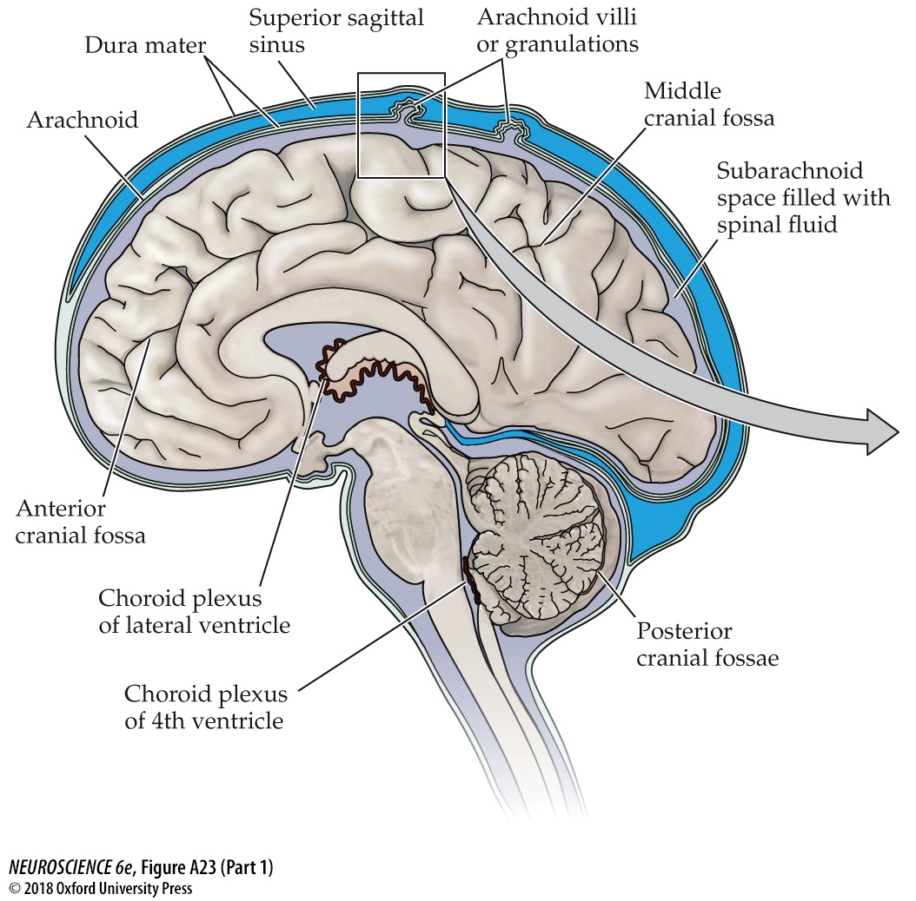
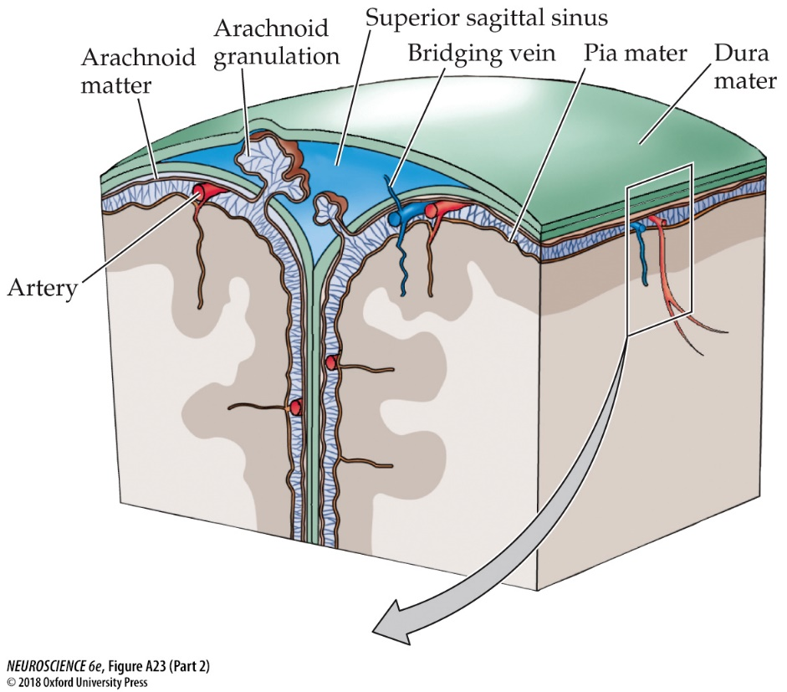
Cerebrospinal Fluid Circulation

Slide 19
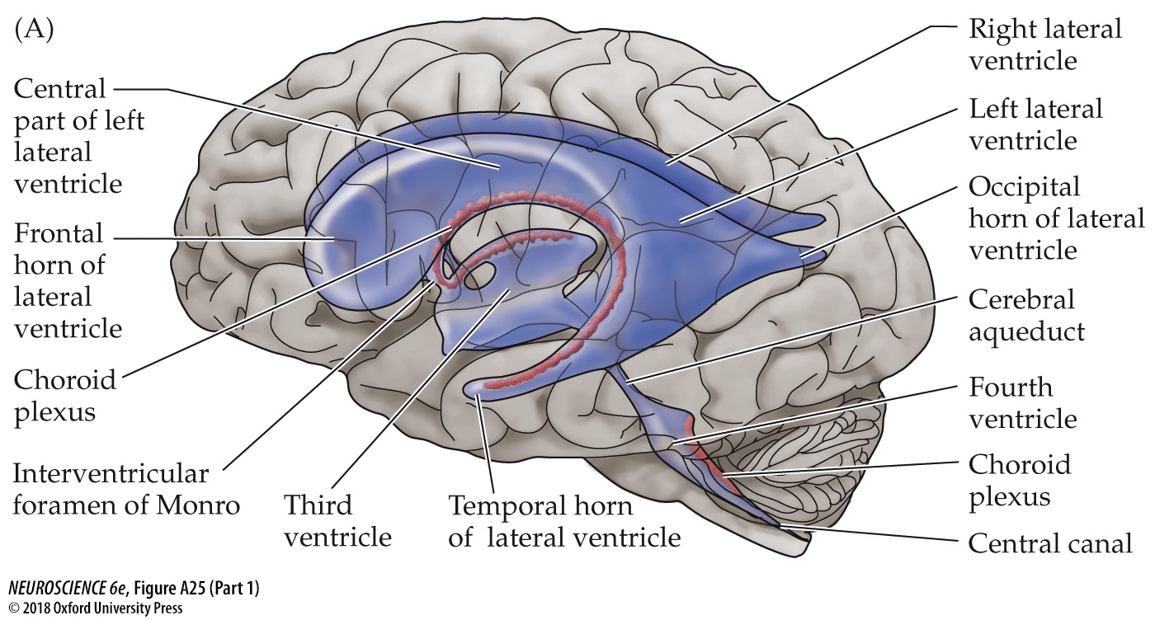
The Ventricles of the Brain

Slide 20
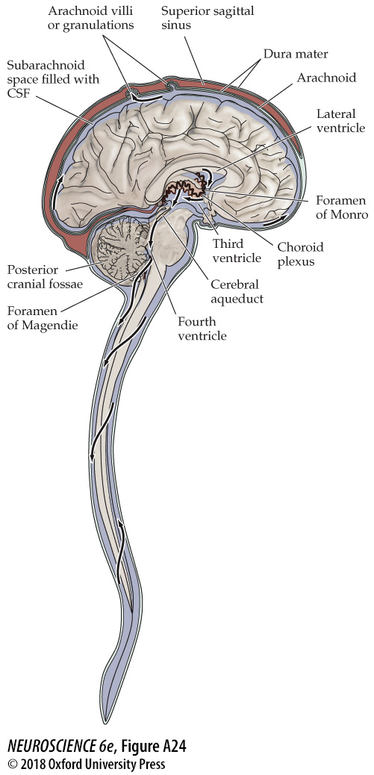
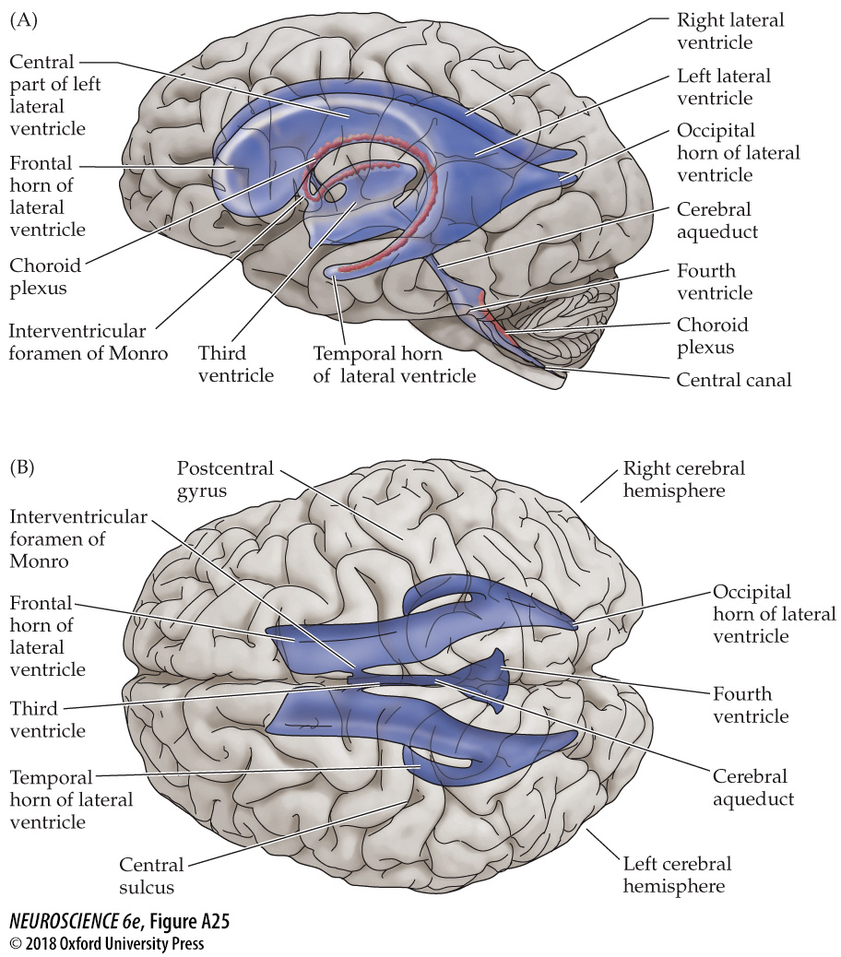
Cerebrospinal Fluid Circulation in the CNS

Slide 21
Question #1
Which of the following are the main roles of cerebrospinal fluid? (You can choose more than one)
To cushion the brain and protect it from injury
To serve as a protective layer around PNS nerves
To deliver nutrients and maintain homeostasis of CNS tissue
To remove waste as part of the brain’s lymphatic system
To act as a reservoir of additional proteins delivered via blood circulation
To facilitate ease of blood flow through the ventricles

Slide 22
Question #2
An infant was diagnosed as having hydrocephalus. It was determined that there was a blockage in the ventricular system of the baby's brain between the third and fourth ventricles. The blockage therefore must have involved the:
The cerebral aqueduct
The central canal
The interventricular
foramina
D. The lateral ventricles

Slide 23
Question #3
The presence of blood in a spinal tap taken from an individual with a closed head injury signals arterial bleeding into the:
Cavernous sinus
Epidural space
Subdural space
D. Subarachnoid space

Slide 24
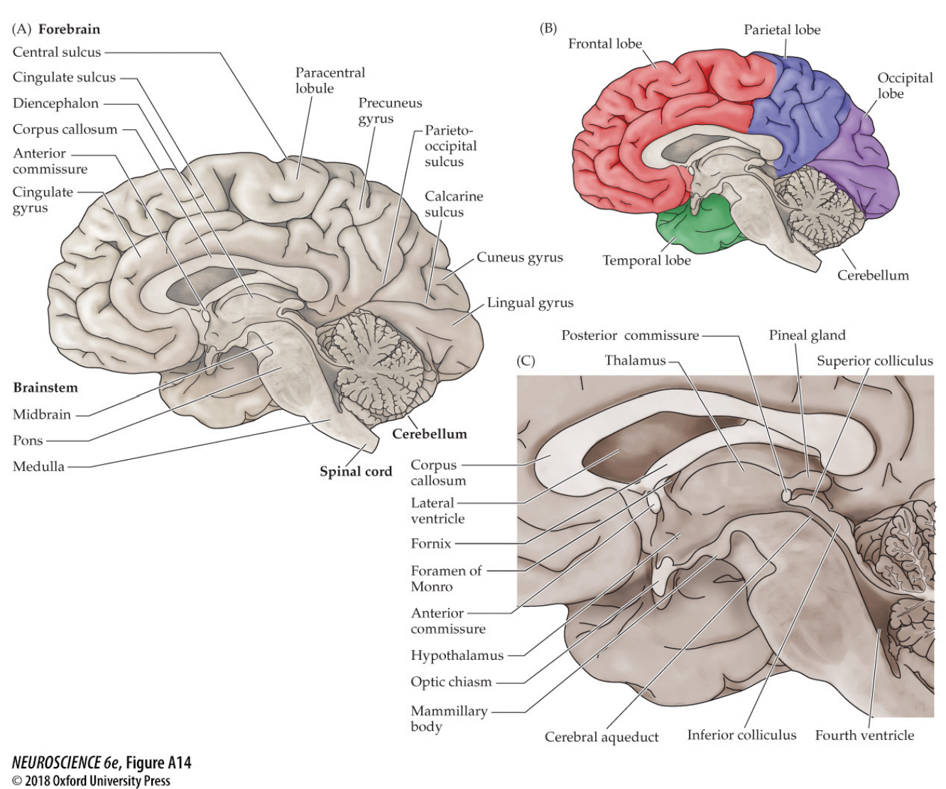
Be sure in particular to review: Figures A4, A12, and A14

Slide 25
If you need more neuroanatomy practice: “Discussion 1 – Neuroanatomy – Activity Slides” on Canvas to practice on your own time Thanks for your participation today – see you next week! ☺

